Slide 1
FM 3rd Party grid components research.
- R & D TPX

Slide 2
1
Candidates
2
Requirements
3
Local Demo
4
Easy to learn

Slide 3
Candidates
Ag-grid
Handsontable
DevExpress

Slide 4
Requirement:
Collapse/Expand grounp lines base on hierarchy
Clipboard control and data preparation
Filter, sort
Performance
Export to csv, excel?(WYSIWYG)
2 lines heading
Date format and transfer
Merge/split cell

Slide 5
Local Demo
Massive data (100,000 rows of data)
Implementation (coding perspective)
Loading time
Scrolling without pagination (virtual scrolling)
Hierarchy group
% trick with clipboard
Export to Excel

Slide 6
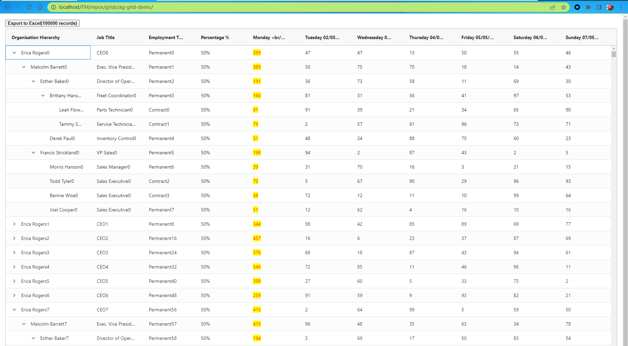
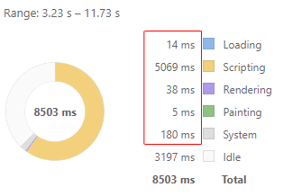
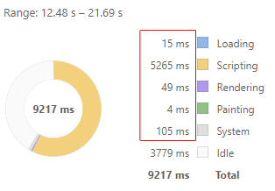
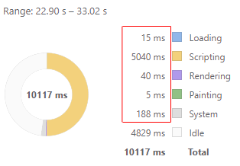
Ag-grid (Local Demo)
100,000 data without pagination (100%)
Hierarchy (100%)
Filter, sorting (80%)
Percentage trick with clipboard(100%)
Exporting, it can export but need extra work to get WYSIWYG (20%)
Implemented with Div + css + Javascript
Loading time (first time loading)(scripting)
背景颜色分组
层级导出到excel缩进

Slide 7
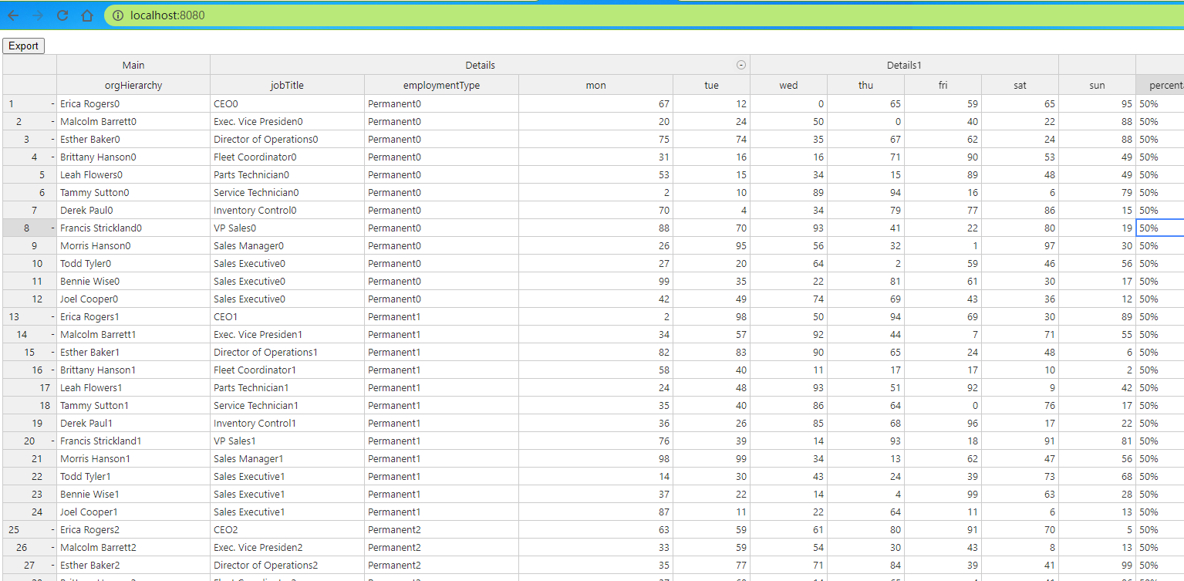
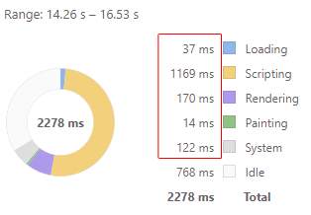
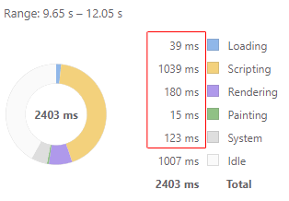
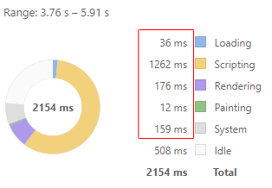
Handsontable (Local Demo)
100,000 data without pagination (100%)
Hierarchy (100%)
Filter, sorting (sorting will break group structure) (80%--??)
Percentage trick with clipboard( 50% --missing copy paste)
Exporting, it can export csv not excel (20% - missing hierarchy info)
Implemented with Div + css + Javascript tr/td/table
Loading time (first time loading)
Colouring on cell, cell background and cell content.

Slide 8
DevExpress
100,000 data without pagination (100%)
Hierarchy (100%)
Filter, sorting (sorting will break group structure) (80%--??)
Percentage trick with clipboard( 50% --missing copy paste)
Exporting, it can export csv not excel (20% - missing hierarchy info)
Implemented with Div + css + Javascript tr/td/table
Loading time (first time loading)

Slide 9
Easy to get on with
Good documentation
Typical samples with explanation
Technical Support

